Slide 1

Welcome
EIC EDGE – Session 2
Notes:
INSTRUCTOR NOTES:
REVIEWER COMMENTS:.

Slide 2
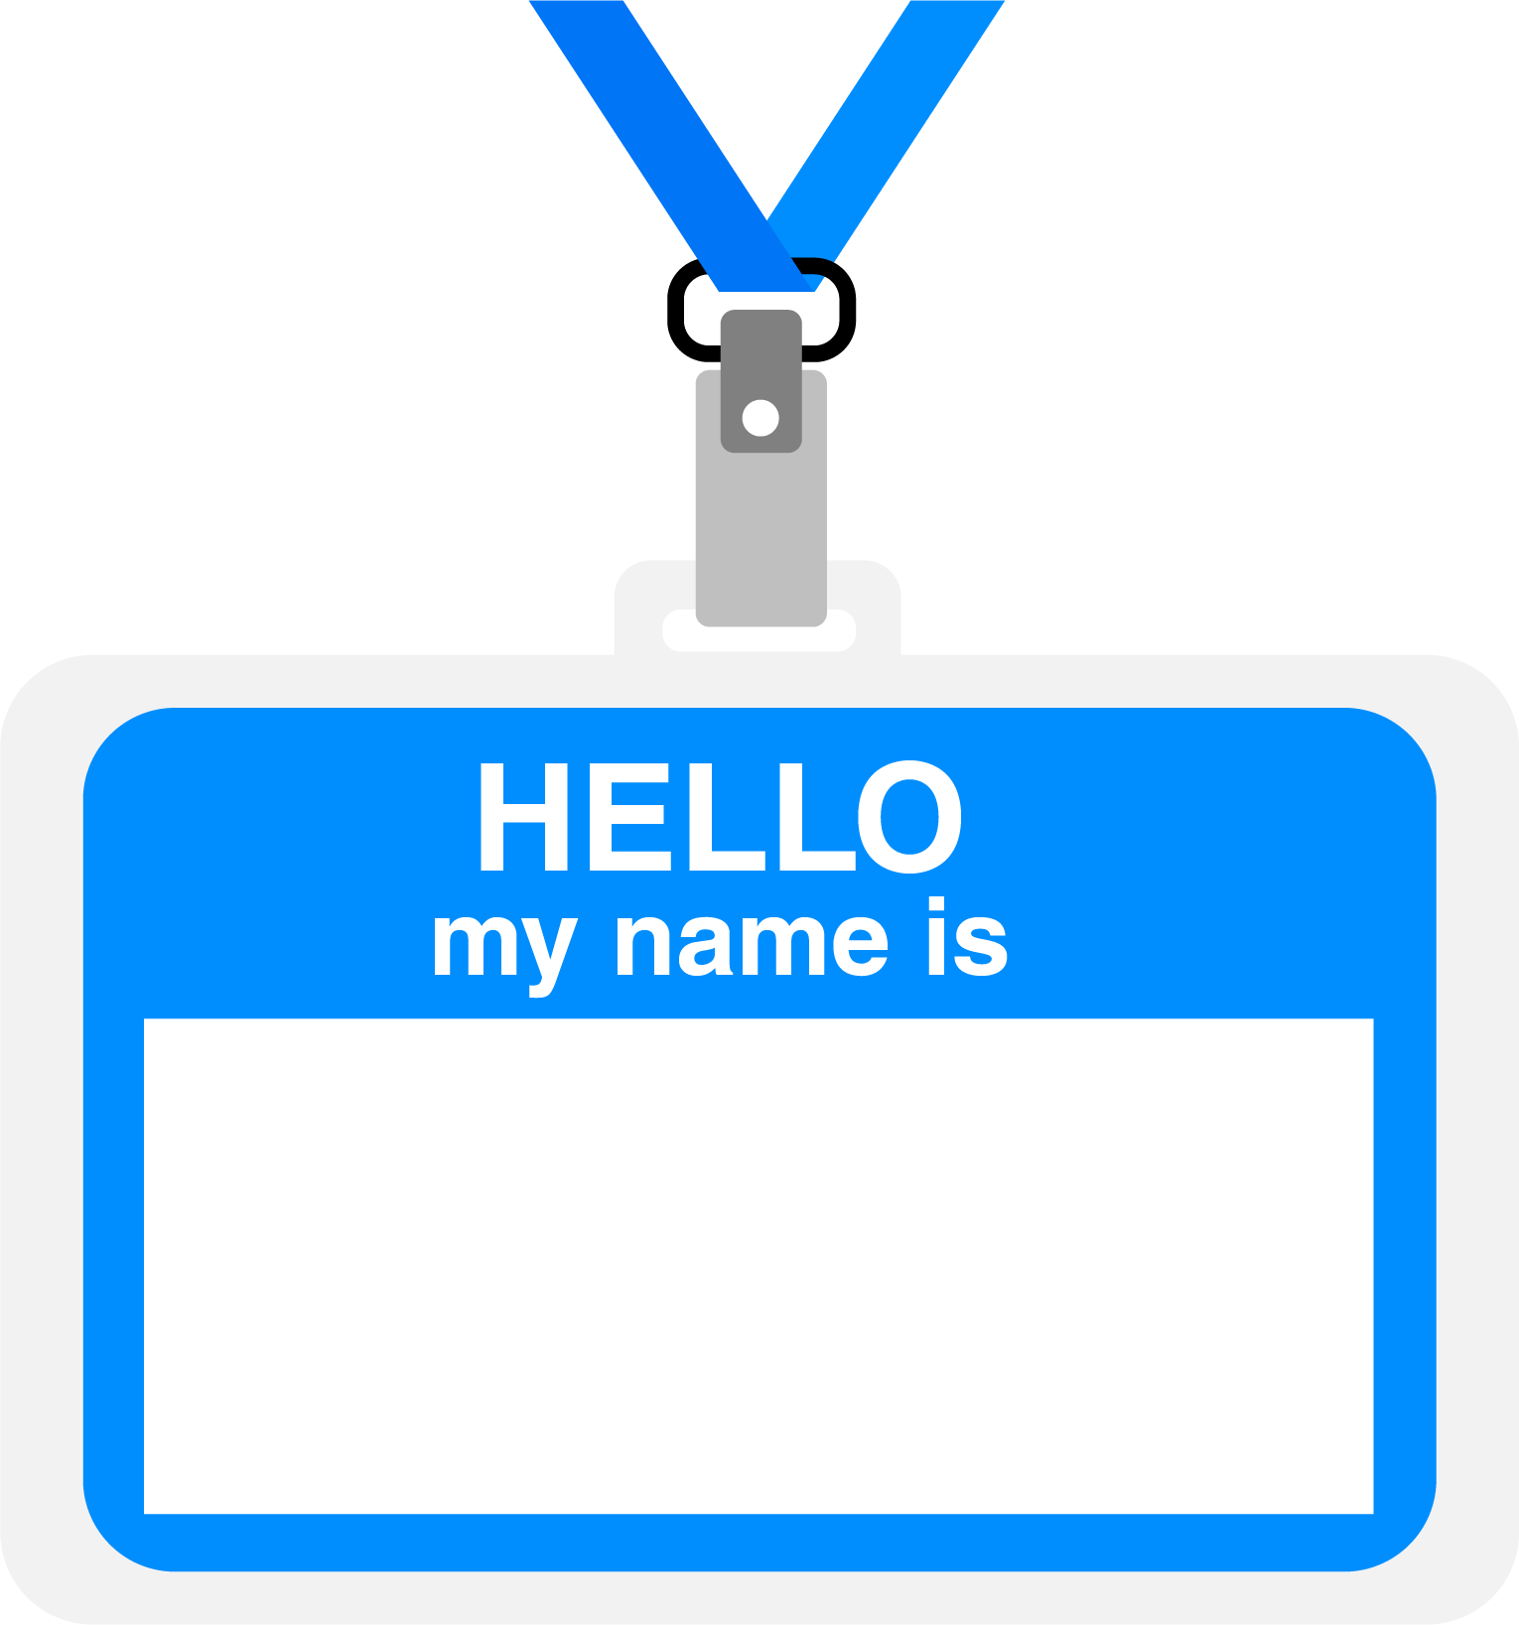
Hello
About me...
Developer
Architect
Author
U.S. Navy veteran
Ran a nuclear sub in Idaho (really!)
Erik Gross (He/Him)
with DevelopIntelligence, a Pluralsight Company.
Notes:
INSTRUCTOR NOTES.
Script: I am [insert name] with DevelopIntelligence. We’re the training partner for [insert client name]. [Provide brief info on your background.]
Wing it!!! Keep it short!!! (Under 2 minutes; less than 1 is even better). Your goal is to establish rapport. You’re just trying to connect with the students. For example...
Here’s a little about my background in case you want this for reference later. Fun fact: [insert a piece of trivia about your personal life…”When I’m not teaching or coding, I am a skydiver”…whatever cool hobby you are engaged in]
Avoid putting your resume here. Say only a sentence or two about your professional credentials and invite them to ask questions about your background or experiences at any point during the training.
REVIEWER COMMENTS:

Slide 3
Prerequisites
This course assumes you
Have some education and experience in Computer Science and software development
Have completed basic onboarding
Completed Session 1 of this program
Notes:
INSTRUCTOR NOTES:
Script: Before we start, I want to make sure everyone is in the correct class. Take a look at these prerequisites and message me in Chat if you have questions or aren’t sure you’re in the right spot.
REVIEWER COMMENTS:

Slide 4
Prerequisites
This course assumes you:
Have some education and experience in Computer Science and software development
Have completed basic onboarding
Notes:
INSTRUCTOR NOTES.
Script: Before we start, I want to make sure everyone is in the correct class. Take a look at these prerequisites and message me in Chat if you have questions or aren’t sure you’re in the right spot.
REVIEWER COMMENTS:

Slide 5
Why study this subject?
Knowing distributed version control is essential in modern SW development
You can understand a group’s work process through version control process
Unit tests, well-used, produce more reliable applications that live longer
Developing with unit tests in mind makes you a better developer
Notes:
INSTRUCTOR NOTES:
Examples...
Learning Python will let you….
You’ll be learning Python so that you can work on XYZ project…
Your organization will be using Python in its upcoming digital transformation project...
REVIEWER COMMENTS

Slide 6

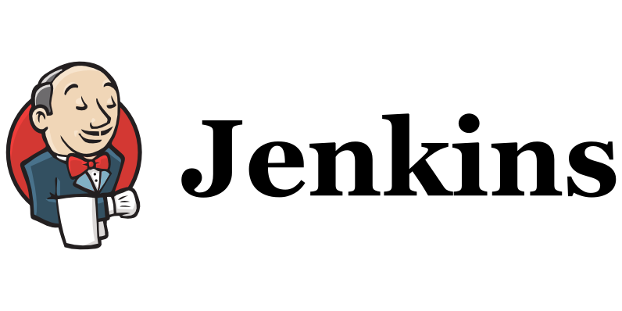






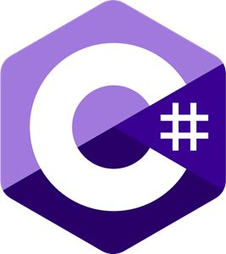








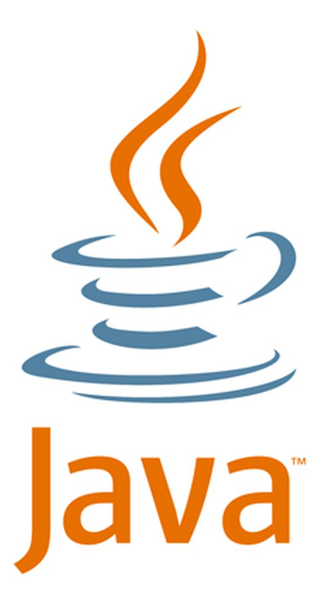









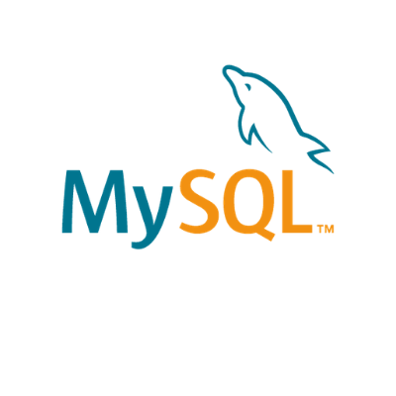

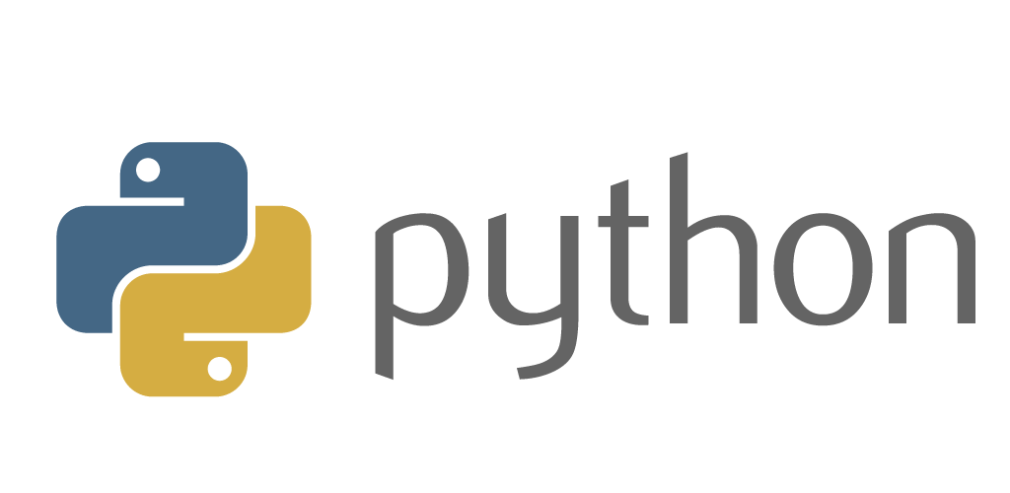



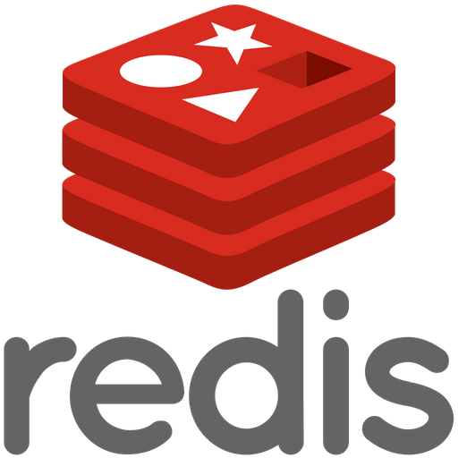




We teach over 400 technology topics
Notes:
INSTRUCTOR NOTES:
Script: DevelopIntelligence teaches a lot of different tech. If there’s a technology you want to learn and you don’t see it in your company’s learning catalog, let your manager know. We’d be glad to help.”
REVIEWER COMMENTS:
PB: Is this slide needed since it is the same cohort from session 1?

Slide 7



You experience our impact on a daily basis!
Notes:
INSTRUCTOR NOTES:
Script: In your everyday life, you come across tech many times a day. When you shop online. When you pay for your morning coffee. When you watch a movie or travel. We train software developers and IT professionals who work on many of the products and services you use daily.
In fact, when you talk on the phone, watch a movie, connect with friends on social media, drive a car, fly on a plane, shop online, and order a latte with your mobile app, you are experiencing the impact of our solutions.
REVIEWER COMMENTS:
PB: This might be an opportunity to ask the class for examples

Slide 8
My pledge to you
I will...
Make this interactive
Ask you questions
Ensure everyone can speak
Create an inclusive learning environment
Use an on-screen timer for breaks
…also, if you have an accessibility need, please let me know
Notes:
INSTRUCTOR NOTES:
Script: This is my pledge to you. I’d like to talk in particular about the third bullet. Sometimes in a class, an enthusiastic participant will want to speak out in every discussion, answer every question and so forth. I want to make sure all of you have the opportunity to be heard. So, if I haven’t heard from you in awhile, I may call on you or check in via chat, because I want to make sure everyone gets their questions answered. Also, I want to demonstrate the timer and confirm that everyone can see it. EggTimer is a good timer - https://e.ggtimer.com/
REVIEWER COMMENTS:
PB: I also want to set the expectation that this is an interactive session and am expecting you to help me keep the course engaging by asking questions, offering comments and leaving your camera on so we can all be active participants in the class.

Slide 9
What I need from you
Could we add a slide with some expectations for the group? I will also send out some expectations ahead of the sessions.
You will..
Turn your camera on during portions of the sessions
Ask questions and participate
Notes:
INSTRUCTOR NOTES:
Script: This is my pledge to you. I’d like to talk in particular about the third bullet. Sometimes in a class, an enthusiastic participant will want to speak out in every discussion, answer every question and so forth. I want to make sure all of you have the opportunity to be heard. So, if I haven’t heard from you in awhile, I may call on you or check in via chat, because I want to make sure everyone gets their questions answered. Also, I want to demonstrate the timer and confirm that everyone can see it. EggTimer is a good timer - https://e.ggtimer.com/
REVIEWER COMMENTS:
PB: I also want to set the expectation that this is an interactive session and am expecting you to help me keep the course engaging by asking questions, offering comments and leaving your camera on so we can all be active participants in the class.

Slide 10
Objectives
At the end of this course you will be able to:
Configure Git locally and work with it locally
Work with remote Git repositories, Pull Requests and workflows
Create fundamental unit tests
Work with the PyTest testing framework
Notes:
INSTRUCTOR NOTES:
Use measurable objectives that start with action verbs such as: describe, define, identify, assess, demonstrate, use, utilize. https://elearningindustry.com/writing-learning-objectives-for-elearning-what-elearning-professionals-should-know
REVIEWER COMMENTS:

Slide 11
Agenda
Day One
Recap of session 1
Distributed Version Control and Git
Lunch (1 hour)
Working locally with Git
Day Two
Working with remote Git repos, Pull Requests and workflows
Lunch (1 hour)
Unit Testing and Test-Driven Development
Notes:
INSTRUCTOR NOTES:
REVIEWER COMMENTS:
PB: Can we assign estimated times for each section? Also, let’s indicate some breaks. We don’t 4 hr. sessions without breaks.

Slide 12
Agenda (continued)
Day Three
Unit Testing frameworks in Python/PyTest
Lunch (1 hour)
Writing Unit Tests in PyTest
Notes:
INSTRUCTOR NOTES:
REVIEWER COMMENTS:

Slide 13
How we’re going to work together
Lab work will take place in individual workspaces – isolated, browser-based virtual machines
Classroom labs may include individual work as well as group discussion and work
I welcome being interrupted – if you need more info, or clarification, or anything else, just break in and ask. I am here to help you.
Notes:
INSTRUCTOR NOTES:.
In this section, discuss the structure of the course—exercises, labs, etc.
Also, discuss any resources students will be using.
REVIEWER COMMENTS:

Slide 14
Recap – Session 1
Notes:
INSTRUCTOR NOTES:
REVIEWER COMMENTS:

Slide 15
Session 1 Subjects and Labs
SDLC (Waterfall vs. Iterative)
Essay: experience with development approaches
Lab: Review/install reference application
Agile Manifesto/Scrum
Lab: Walk through Agile/Scrum sprint
JIRA basic operation/Kanban boards
Demo: Lifecycle of JIRA issue
Lab: Break down large story
Intro to DevOps
Demo: Manual deployment
Demo: SQL injection attack
Notes:
INSTRUCTOR NOTES:
REVIEWER COMMENTS:
PB: What is going to be discussed? Are you planning to ask the class if there is anything in particular they want to review – either now or offline?

Slide 16
Distributed Version Control and Git
Notes:
INSTRUCTOR NOTES:
REVIEWER COMMENTS:

Slide 17
What is Version Control?
Programs AND work practices that we use to track and control text documents
What documents? Source code - the text files we use to create our executable program
Helps facilitate multiple contributors on a project
Allows us to revert to previous iterations of code base as needed
Notes:
INSTRUCTOR NOTES:
REVIEWER COMMENTS:
PB: Who can give me an example?

Slide 18
The Past: Client/Server Version Control
Prior to 10-15 years ago, most version control used client/server model:
One computer (version control server) had all source code files; it was usually on-site
Client computers (devs) could “check out” a file with the server – that would lock the file to changes
When dev done with work, submits change to server
Once change is made, the file is unlocked for others to modify
Disadvantage: geographically distributed teams weren’t possible; multiple devs can’t work on the same file
Notes:
INSTRUCTOR NOTES:
REVIEWER COMMENTS:

Slide 19
The Present: Distributed Version Control
The source code files are distributed – a full copy of all files, and their entire history, exists on every developers’ computer
Multiple devs can work on the same file simultaneously – when they merge, a computer program will handle routine merge actions; merge conflicts are raised for human interaction
There are a few popular programs:
Subversion
Mercurial
Git
Git is by far the most popular
Notes:
INSTRUCTOR NOTES:
REVIEWER COMMENTS:

Slide 20
How Git Works
A “complete history” of all versions of the code is on every machine that contributes to that code
These collected versions are called “repositories”
IMPORTANT: A new “version” of a file doesn’t contain the full file contents – it just contains the DIFFERENCES between the previous version and the new version
These “diff” files are used to reconstruct previous versions of the code
This means the whole historical record takes up a LOT less space than if we stored the actual files
Notes:
INSTRUCTOR NOTES:
REVIEWER COMMENTS:

Slide 21
Git: Who Do You Trust?
If every computer working on a project has a repository (repo), and every repo has a complete copy of the history, whose repo should we use to initiate change?
Fun fact: ANY one of the repos can be used – after the change, we just tell everyone to sync up their repo with the one that just changed
This is NOT fun to manage. Instead, most teams create one “central” repo, and initiate changes to the code base there.
IMPORTANT: This idea of a “central” repo is only an idea, and needs to be kept true by process
This central repo is usually considered the “source of truth” as far as current state of the code base
Notes:
INSTRUCTOR NOTES:
REVIEWER COMMENTS:
PB: This is an opportunity to show the question first, solicit responses, then show/discuss the balance of text

Slide 22
Git: It’s Like the Wild West
There are no rules about how to set up and use Git. You can do basically anything with it as far as workflow
This means teams must decide what to do, and enforce it via common agreement and/or enforced practices
The most common pattern:
Set up one repo where no dev work gets done.
Consider that this is the “source of truth” repo.
All change initiates here.
Dev repos exist locally on dev machines.
To the dev repos, the “source of truth” repo is considered a “remote” repo
Notes:
INSTRUCTOR NOTES:
REVIEWER COMMENTS:

Slide 23
Working Locally with Git
Notes:
INSTRUCTOR NOTES:
REVIEWER COMMENTS:

Slide 24
Local Git Operations – Why Should We Care?
Why does version control matter on a local repo?
Should we use version control on a project where we will be the only contributor?
Notes:
INSTRUCTOR NOTES;
REVIEWER COMMENTS:
PB: Good opportunity to perhaps pose this with a multiple choice and tally responses

Slide 25
DEMO:
Demo version control on local files
Local Git operation
Notes:
INSTRUCTOR NOTES:
REVIEWER COMMENTS:
PB: Can some detail of the demo be provided here? I would believe CG would want to be seeing that

Slide 26
Local Git Operations – Create a Repo
.git folder
.gitignore folder
Notes:
INSTRUCTOR NOTES:
REVIEWER COMMENTS:

Slide 27
Local Git Operations – Creating Files
Not tracked by Git unless you specify it
Notes:
INSTRUCTOR NOTES:
REVIEWER COMMENTS:

Slide 28
Local Git Operations – Staging Changes
Track a file and stage any changes to it – a periodic “checkpoint” on your work
Notes:
INSTRUCTOR NOTES:
REVIEWER COMMENTS:

Slide 29
Local Git Operations – Committing Changes
Making some (or all) of your staged changes a permanent part of version history
Notes:
INSTRUCTOR NOTES:
REVIEWER COMMENTS:

Slide 30
LAB:
Create local repository and perform Git operations on local files
Local Git operation
Notes:
INSTRUCTOR NOTES:
REVIEWER COMMENTS:
PB: Need to create a summary of actions or something similar to explain the lab

Slide 31
Working with Remote Repos
Notes:
INSTRUCTOR NOTES:
REVIEWER COMMENTS
PB: Need a slide in front of this that sections this as Day 2 and reviews what was learned the day before and asks whether there are any questions.

Slide 32
Remote Repos – the “Source of Truth”
Relationship between local repos and remote repos
Deciding where to put remote repos
Danger of initiating changes to source code away from the primary remote repo
Notes:
INSTRUCTOR NOTES:
REVIEWER COMMENTS:
PB: Challenge question: What are the repercussions – dangers – of making changes away from the primary remote repo?

Slide 33
How to set up a remote repo for your local repo
Git commands
The value of an alias for your remote repos
Notes:
INSTRUCTOR NOTES:
REVIEWER COMMENTS:

Slide 34
Cloning a repo from remote to local
Git commands
Modern conventions for naming the primary branch on a repo
Notes:
INSTRUCTOR NOTES:
REVIEWER COMMENTS:
PB: Before moving to the next section, perhaps build a Knowledge Check question for the class to answer as a review. Then offer a brief break before starting the next section.

Slide 35
Git Workflows
Notes:
INSTRUCTOR NOTES:
REVIEWER COMMENTS:

Slide 36
What is a Git Workflow?
Arbitrary set of agreements about how to manage work on a distributed code base
Mainly address how to create and manage branches
Several popular approaches
Git Flow
GitHub Flow
GitLab Flow
Notes:
INSTRUCTOR NOTES:
REVIEWER COMMENTS:
PB: Hide your bullets and pose this as a challenge question first: Can anyone tell me what a Git Workflow is?

Slide 37
How does Git Flow work?
Proposed by Vincent Driessen in 2010: https://nvie.com/posts/a-successful-git-branching-model/
Very popular, although most dev groups tweak it a little
Driessen updated his thoughts on it in 2020; see the linked article
Notes:
INSTRUCTOR NOTES:
REVIEWER COMMENTS:

Slide 38
Pull Requests
Notes:
INSTRUCTOR NOTES:
REVIEWER COMMENTS:

Slide 39
Pull Requests
Code review – usually of proposed change to the primary branch in a repo
Ideally includes actually pulling changes onto the reviewer’s machine and executing the code
May be informal, or enforced by rules in the source control management platform
Notes:
INSTRUCTOR NOTES:
REVIEWER COMMENTS:

Slide 40
DEMO:
Show full workflow described in Git Flow article
Git Flow
Notes:
INSTRUCTOR NOTES:
REVIEWER COMMENTS:

Slide 41
LAB
Have students perform full workflow described in Git Flow article
Includes creating a PR and getting it approved by the instructor
Git Flow
Notes:
INSTRUCTOR NOTES:
REVIEWER COMMENTS:
PB: Similar to previous Lab comments: layout steps/Process for the lab

Slide 42
Unit Testing
Notes:
INSTRUCTOR NOTES:
REVIEWER COMMENTS
PB: Need a slide in front of this that sections this as Day 3 and reviews what was learned the day before and asks whether there are any questions.

Slide 43
Unit Testing – What is a “unit of work”?
Any code logic exposed through public methods
Often, it returns a value, changes the internals of the system, or a makes a call to external code
Notes:
INSTRUCTOR NOTES:
REVIEWER COMMENTS:
PB: Similar format: Hide bullets, ask the group the question first

Slide 44
DEMO
Show several examples of methods in the reference implementation that are a “unit of work”, by stepping through the code
Unit of Work
Notes:
INSTRUCTOR NOTES:
REVIEWER COMMENTS:

Slide 45
Unit Testing – What is a “unit test”?
An automated test that calls a unit of work, and then checks a single assumption about the behavior of that unit of work
They give us confidence: at present, our code is well-written; in the future, if something breaks our code, we’ll know right away
Notes:
INSTRUCTOR NOTES:
REVIEWER COMMENTS:

Slide 46
Unit Testing – Arrange/Act/Assert pattern
General description of how to set up and perform a unit test
Arrange: Set up conditions for calling the unit of work, such that all factors are known, except the factor we want to test
Act: Call the unit of work we want to test
Assert: Check the state of the factor we want to test to see if it is as expected
Notes:
INSTRUCTOR NOTES:
REVIEWER COMMENTS:

Slide 47
DEMO
Show a unit test in action in the reference application, both on an automated run and by stepping through the code
Use the unittest library for this
Unit Test
Notes:
INSTRUCTOR NOTES:
REVIEWER COMMENTS:

Slide 48
What makes a good unit test?
Tests run quickly – we don’t want to create a testing backlog in an environment where devs are pushing small changes, frequently
Tests are deterministic – for a given set of (controlled) inputs, the test should always produce the same result
Test should be able to be run in any order – no one test relies on any other test being performed first; they run in a vacuum
Tests validate themselves – we shouldn’t need any external verification of test performance
Notes:
INSTRUCTOR NOTES:
REVIEWER COMMENTS:

Slide 49
LAB
Write two unit tests for a given function in the reference application
Use the unittest library for this
Unit Tests
Notes:
INSTRUCTOR NOTES:
REVIEWER COMMENTS:
PB: Similar to previous Lab comments: layout steps/Process for the lab

Slide 50
Test Driven Development
Notes:
INSTRUCTOR NOTES:
REVIEWER COMMENTS:

Slide 51
What if we wrote our tests first?
Test Driven Development reverses the usual
Devs have to devise a test that will verify correct operation of a function before they even write the function
This forces you to write functions that “do one thing, and do it well”
Notes:
INSTRUCTOR NOTES:
REVIEWER COMMENTS:
PB: Question: When should you consider Test Driven Development?

Slide 52
Test Driven Development – basic sequence
Write a unit test for the function you’re about to create
Run the test – it should fail
Write the function
Test it
If it fails, re-examine your test and change it if your logic was wrong
Otherwise, refactor your function until it passes
Write another test - repeat
Notes:
INSTRUCTOR NOTES:
REVIEWER COMMENTS:

Slide 53
DEMO
Demo TDD with a new test, followed by creation of a new function, all in the reference application
Test Driven Development
Notes:
INSTRUCTOR NOTES:
REVIEWER COMMENTS:

Slide 54
LAB
Practice TDD by thinking of a function to add to the reference application (see instructor for ideas), then writing and refactoring it until the test passes
See instructor for any help needed in designing the test or the function
Test Driven Development
Notes:
INSTRUCTOR NOTES:
REVIEWER COMMENTS:
PB: Similar to previous Lab comments: layout steps/Process for the lab

Slide 55
Unit Testing Frameworks
Notes:
INSTRUCTOR NOTES:
REVIEWER COMMENTS:

Slide 56
Purpose of a unit testing framework
Help you write and run unit test
Provide test reporting
Manage collections of unit tests
Implement testing strategies that vary according to testing needs
Notes:
INSTRUCTOR NOTES:
REVIEWER COMMENTS:

Slide 57
Popular unit testing frameworks for Python
PyTest
Robot
Unittest (we will use this for our work)
DocTest
Nose2
Notes:
INSTRUCTOR NOTES:
REVIEWER COMMENTS:

Slide 58
Where does a unit test come in the development cycle?
VERY IMPORTANT FACT: Unit tests are NOT executed on a running instance of your application. They are run using ONLY your source code
This means they can be run before you use valuable resources to build and deploy your app, catching problems early
Notes:
INSTRUCTOR NOTES:
REVIEWER COMMENTS:

Slide 59
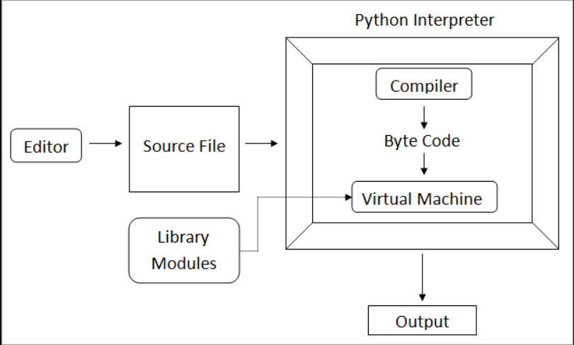
How does unit testing work under the hood?
Notes:
INSTRUCTOR NOTES:
REVIEWER COMMENTS:
PB: Instructor notes are needed to discuss this slide

Slide 60
Writing Unit Tests in UnitTest
Notes:
INSTRUCTOR NOTES:
REVIEWER COMMENTS:

Slide 61
Features of UnitTest
Less boilerplate code that other libraries/frameworks
Enables state and dependency management via “fixtures”
Allows test filtering, tailoring test runs to your needs
Provides for test parameterization
Easily extended
Notes:
INSTRUCTOR NOTES:
REVIEWER COMMENTS:

Slide 62
PyTest: Managing state for your test
We often need collection of objects, in a specific state, for our tests
We can use a “fixture” in PyTest to create and shape data to our needs – and then use that data structure across multiple tests
Notes:
INSTRUCTOR NOTES:
REVIEWER COMMENTS:

Slide 63
DEMO
Create a PyTest fixture and use it in two unit tests
PyTest Fixture
Notes:
INSTRUCTOR NOTES:
REVIEWER COMMENTS:

Slide 64
LAB
Create a PyTest fixture and use it in two unit tests
PyTest Fixture
Notes:
INSTRUCTOR NOTES:
REVIEWER COMMENTS:
PB: Similar to previous Lab comments: layout steps/Process for the lab

Slide 65
PyTest: Categorizing test
We may not always want to run every test – some might take too long for our situation, for example
We can control which tests are run by tagging them, and running only matching tests
Notes:
INSTRUCTOR NOTES:
REVIEWER COMMENTS:

Slide 66
DEMO
Tag a subset of our tests and show test runs on all tests/tagged tests
Tagging Tests
Notes:
INSTRUCTOR NOTES:
REVIEWER COMMENTS:

Slide 67
LAB
Tag a subset of your tests and perform test runs on all tests/tagged tests
Tagging Tests
Notes:
INSTRUCTOR NOTES:
REVIEWER COMMENTS:
PB: Similar to previous Lab comments: layout steps/Process for the lab

Slide 68
PyTest: Duration reports
PyTest reports include a built-in duration report
This helps you triage which tests to exclude if you need to speed up your builds
Notes:
INSTRUCTOR NOTES:
REVIEWER COMMENTS:

Slide 69
DEMO
Run a duration report on our tests. Change the tag on a long-running test to exclude it as needed. Re-run the tests, excluding that test.
Duration Report
Notes:
INSTRUCTOR NOTES:
REVIEWER COMMENTS:

Slide 70
LAB
Run a duration report on Your tests. Change the tag on a long-running test to exclude it as needed. Re-run the tests, excluding that test.
Duration Report
Notes:
INSTRUCTOR NOTES:
REVIEWER COMMENTS:
PB: Similar to previous Lab comments: layout steps/Process for the lab

Slide 71




Thank you!
If you have additional questions, please reach out to me at:
erik-gross@pluralsight.com
Notes:
INSTRUCTOR NOTES:
REVIEWER COMMENTS:
PB: I would like to see a slide or two before this that: 1) summarizes the last three days and affords the opportunity for general wrap up comments from the students, 2) emphasizes the importance of taking the post Skills online courses to reenforce what has been taught and will help as a reference to retain many of the things discussed in class.

